Slide 1

Dr. NGP INSTITUTE OF TECHNOLOGY
22UAD801- PROJECT WORK
Review 2
AI-POWERED BREED IDENTIFICATION SYSTEM FOR DAIRY CATTLE AND BUFFALOES
Presented by,
ARUNIKA G (710722243005)
NAVYA N J (710722243034)
RITHANYA V (710722243040)
Under the Guidance of
Dr. I. Devi B.E., M.E., PhD.,
Assistant Professor (Sr.Gr.)

Slide 2
Objective
Dr. NGP INSTITUTE OF TECHNOLOGY
Velalar College of Engineering and Technology
The objective of this project is to design and develop an AI-powered breed identification system for dairy cattle and buffaloes using image-based deep learning techniques. The system aims to accurately classify indigenous breeds under real-world farm conditions and improve the quality of livestock data used for breeding, insurance, and government schemes.
Specific Objectives:
To automate breed identification using image-based analysis.
To perform automated breed identification using deep learning based image classification techniques
To provide a practical and user-friendly solution suitable for real-time usage.

Slide 3
Introduction
Dr. NGP INSTITUTE OF TECHNOLOGY
Velalar College of Engineering and Technology
The livestock sector plays a vital role in India’s rural economy, supporting agricultural productivity and farmer livelihoods through dairy cattle and buffaloes.
Accurate breed identification is essential for effective breeding programs, nutrition planning, disease control, insurance, and policy decisions.
The Government of India introduced the Bharat Pashudhan App to digitally record breeding, health, and nutrition data of livestock.
However, manual breed identification by field workers often leads to misclassification, so this project proposes an AI-based YOLO model to classify cattle and buffalo breeds from images.

Slide 4
Abstract
Dr. NGP INSTITUTE OF TECHNOLOGY
Velalar College of Engineering and Technology
India is home to 50+ recognized cattle and buffalo breeds, each with unique genetic, productivity, and disease-resistance traits. Accurate breed identification is vital for breeding, nutrition planning, and disease control. Currently, manual identification by FLWs leads to frequent misclassification, resulting in poor-quality data in national livestock databases.
This project proposes a deep learning–based breed identification system using image-based analysis, which will detect and classify breeds from captured images.
Suggest accurate breed names in real time.
Enhance reliability of government records and assist in effective policy-making
8-Mar-26
Department of AI&DS
4

Slide 5
Dr. NGP INSTITUTE OF TECHNOLOGY
Velalar College of Engineering and Technology
Problem Statement
Manual livestock breed identification:
Depends heavily on human expertise
Leads to misclassification
Causes incorrect livestock database entries
Affects government schemes, insurance, and breeding strategies
There is no scalable, automated, and accurate system available for breed identification in real-time field conditions.
8-Mar-26
8-Mar-26
Department of AI&DS
Department of AI&DS
5
5

Slide 6
Dr. NGP INSTITUTE OF TECHNOLOGY
LITERATURE SURVEY 1
Image-Based Breed Recognition of Indian Cattle and Buffaloes Using YOLOv12 and Roboflow Cloud Platform (Year:2025) Authors: Aashish Chauhan, Ajit Kumar Gupta, Garvit Paliwal, Gautam Singh, Harshit Singh, Dr. Umesh Dwivedi
This study presents BreedVision, an AI-powered web system for automated cattle and buffalo breed recognition. The approach uses YOLOv12 object detection trained on 3,683 annotated images covering 15 major Indian breeds.
Real-time classification is achieved by integrating ReactJS frontend with a Python Flask backend and a Roboflow cloud inference engine
8-Mar-26
6

Slide 7
Dr. NGP INSTITUTE OF TECHNOLOGY
LITERATURE SURVEY 2
Development of a Lightweight Deep Learning Model for the Identification and Classification of Indigenous Cattle Breeds (Year: 2025) Authors: Shruti Arya, Indu Devi, Divyanshu Singh Tomar, Man Singh, Radhika Warhade, Anshul Gautam, T. K. Mohanty
This research focuses on differentiating phenotypically similar indigenous cattle breeds (e.g., Tharparkar and Hariana) using a deep learning-based segmentation and classification pipeline. This work highlights the challenge of similar visual appearance and the need for segmentation before classification in breed recognition.
8-Mar-26
Department of AI&DS
7

Slide 8
Dr. NGP INSTITUTE OF TECHNOLOGY
LITERATURE SURVEY 3
Buffalo Identification in Mixed-Species Environments: A Comparative Deep Learning Approach Using ResNet50 and EfficientNetB3 (Year: 2025) Authors: Nagaraj Naik (Manipal Institute of Technology), Ramu S. (Siddaganga Institute of Technology)
This study compares the performance of ResNet50 and EfficientNetB3 for visual buffalo identification in mixed species scenarios. By curating a balanced dataset with multiple classes (buffalo, elephant, rhino, zebra), the research evaluates how CNN architectures distinguish buffaloes from other large mammals, demonstrating the effectiveness of deeper networks in complex visual classification challenges
8-Mar-26
Department of AI&DS
8

Slide 9
Dr. NGP INSTITUTE OF TECHNOLOGY
LITERATURE SURVEY 4
Ensemble Learning Algorithm for Cattle Breed Identification Using Computer Vision Techniques (Year: 2024) Authors: Vijayalakshmi A, P. Shanmugavadivu, S. Vijayalakshmi, Shreyansh Padarha, Sivaranjani R
This research proposes an ensemble learning approach for cattle breed identification by combining multiple computer vision techniques including CNN, YOLO object detection, Canny edge detection, k-means segmentation, and grayscale imaging. The ensemble classifier uses a voting mechanism to improve robustness against obscured features and environmental noise, suggesting that hybrid methods can address limitations of individual models.
8-Mar-26
9

Slide 10
Dr. NGP INSTITUTE OF TECHNOLOGY
LITERATURE SURVEY 5
Automatic Cattle Breed Identification Using Transfer Learning and Deep CNN (Year: 2021) Authors: K. Kumar, R. Verma
The study uses transfer learning with deep convolutional neural networks such as VGG16 and ResNet50 for cattle breed identification. Using pre-trained ImageNet models helps improve accuracy and reduces training time, especially when datasets are limited. Data augmentation techniques (rotation, flipping, brightness adjustment) were applied to improve model performance. The research shows that transfer learning is an effective approach for agricultural AI systems, enabling efficient and scalable breed classification.
8-Mar-26
10

Slide 11
Dr. NGP INSTITUTE OF TECHNOLOGY
LITERATURE SURVEY 6
Deep Learning-Based Animal Classification in Precision Livestock Farming (Year: 2022) Authors: P. Guarnido-Lopez, J. Y. Lee
The research reviews the use of deep learning techniques for applications in precision livestock farming, including breed identification, health monitoring, and behaviour analysis. It analyses architectures such as CNNs, YOLO-based detectors, and recurrent neural networks used in agricultural systems. The study highlights that automated livestock monitoring systems can improve farm productivity and reduce manual labour while addressing challenges like dataset variability, lighting conditions, and deployment in rural environments.
8-Mar-26
11

Slide 12
Dr. NGP INSTITUTE OF TECHNOLOGY
LITERATURE SURVEY 7
Application of Deep Convolutional Neural Networks for Fine-Grained Animal Breed Classification (Year: 2019) Authors: Y. Liu, H. Zhang
The study applies deep convolutional neural networks (CNNs) for fine-grained animal breed classification, where categories have very subtle visual differences. The proposed model extracts hierarchical features from images, focusing on regions such as head shape, ear position, horn curvature, and coat texture. Attention mechanisms and deeper networks with residual connections improve classification performance by capturing subtle variations between breeds. The research highlights that advanced CNN architectures and feature localization techniques are effective for accurate livestock breed identification systems.
8-Mar-26
12

Slide 13
Dr. NGP INSTITUTE OF TECHNOLOGY
Existing System
In India, cattle and buffalo breed identification is mostly carried out through manual visual inspection by Field Level Workers (FLWs).
Breed identification is based on physical characteristics such as coat color, body structure, horn shape, and size.
The process depends heavily on human expertise and experience, making it inconsistent across regions.
Some AI-based research systems and online breed classifier applications have been developed, but they are mostly limited to experimental or small-scale usage.
8-Mar-26
8-Mar-26
Department of AI&DS
13
13

Slide 14
Dr. NGP INSTITUTE OF TECHNOLOGY
Existing System
Manual identification errors: Breed classification depends on worker experience and training.
Difficulty identifying similar breeds: Many cattle and buffalo breeds have very similar physical features.
Lack of AI-based validation: No automated system to verify breed information during registration.
Limited AI solutions and datasets: Existing research models have small datasets and poor real-world generalization.
Scalability and environmental challenges: Variations in lighting, background, and camera angles affect accuracy, and systems are not easily scalable for nationwide use.
8-Mar-26
8-Mar-26
Department of AI&DS
14
14

Slide 15
Dr. NGP INSTITUTE OF TECHNOLOGY
Proposed System
The proposed system is an AI-powered breed identification system for dairy cattle and buffaloes that uses a deep learning–based image classification model for breed identification
Key Features / Improvements:
Utilizes deep learning techniques for automatic feature extraction and breed classification for deep feature learning and better discrimination between visually similar breeds.
Focuses on classification-oriented modeling rather than detection-first approaches.
Robust performance under real-world farm conditions, including variations in lighting and background.
Designed for scalable deployment, with future support for offline and edge inference.
Can be integrated with livestock management and government breed databases for practical use.
8-Mar-26
8-Mar-26
8-Mar-26
Department of AI&DS
Department of AI&DS
15
15
15

Slide 16
Dr. NGP INSTITUTE OF TECHNOLOGY
Proposed System: Workflow & Architecture
Image Upload: Users upload cattle or buffalo images through a web-based interface.
Image Preprocessing: The system performs image resizing, normalization, and format validation to prepare the image for model processing.
Deep Learning Model (YOLO): The trained model analyzes visual features such as coat pattern, horn shape, body structure, and facial characteristics to classify the breed.
Prediction Output: The system displays the predicted breed along with a confidence score.
Future Integration: The system can be integrated with the Bharat Pashudhan App for real-time breed validation during livestock registration.
8-Mar-26
8-Mar-26
8-Mar-26
Department of AI&DS
Department of AI&DS
16
16
16

Slide 17
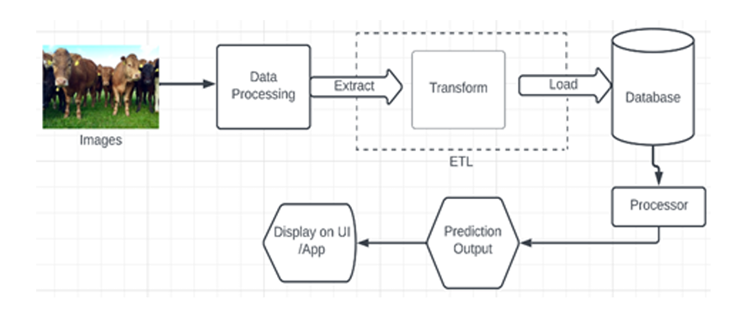
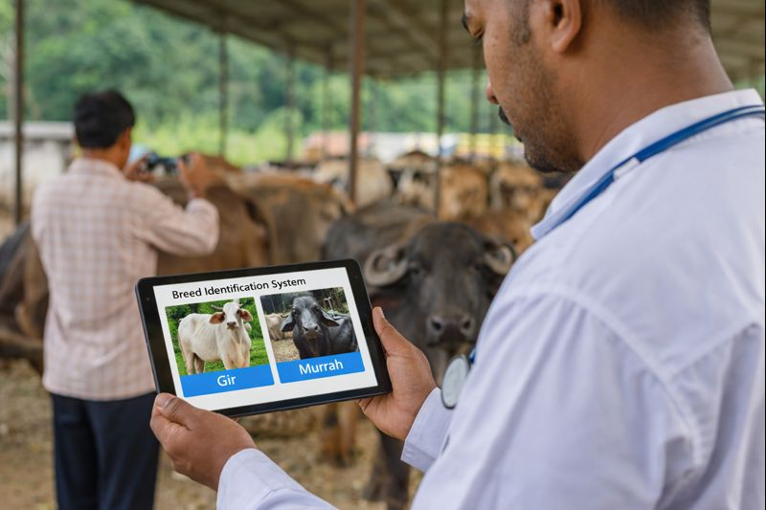
Dr. NGP INSTITUTE OF TECHNOLOGY
Proposed Architecture Block diagram
8-Mar-26
Department of AI&DS
17

Slide 18
Dr. NGP INSTITUTE OF TECHNOLOGY
Modules
Image Acquisition Module
Image Preprocessing Module
Feature Extraction Module (Deep Learning Model)
Breed Classification Module (Image-based Classifier)
Prediction & Result Analysis Module
User Interface & Deployment Module

Slide 19
Dr. NGP INSTITUTE OF TECHNOLOGY
Module Description
MODULE 1: Image Acquisition Module
Purpose:
Manages the capture or upload of cattle and buffalo images from mobile devices or cameras under real-time farm conditions.
Key Functions :
Allows users to upload images through a web interface.
Images can be captured using mobile phones or digital cameras.
Supports common image formats such as JPEG and PNG.

Slide 20
Dr. NGP INSTITUTE OF TECHNOLOGY
Module Description
MODULE 1: Image Acquisition Module
Working:
The module validates uploaded images before processing.
Ensures that the image is not corrupted
Meets minimum resolution requirements
Simulates real farm conditions where lighting, posture, and background may vary.
Provides structured input for the AI pipeline.

Slide 21
Dr. NGP INSTITUTE OF TECHNOLOGY
Module Description
MODULE 2: Image Preprocessing Module
Purpose:
Enhances and standardizes the captured images to make them suitable for deep learning model input.
Why preprocessing is needed
Farm images may contain:
Uneven lighting
Shadows
Background noise
Resolution variations
Preprocessing helps improve model accuracy and reliability.

Slide 22
Dr. NGP INSTITUTE OF TECHNOLOGY
Module Description
MODULE 2: Image Preprocessing Module
Working:
Preprocessing steps include:
Image resizing to match YOLO model input size
Pixel normalization
Conversion to tensor format for
Ensuring proper RGB channel ordering
Benefits:
Standardized input data
Reduced environmental noise
Improved classification performance

Slide 23
Dr. NGP INSTITUTE OF TECHNOLOGY
Module Description
MODULE 3: Feature Extraction Module
Purpose:
Automatically extracts meaningful visual features from images using convolutional neural networks.
Key Features: Automatic feature learning, extraction of texture and shape patterns, elimination of manual feature engineering
Implementation:
Uses the backbone network of YOLO architecture.
Multiple convolution layers analyze visual patterns in the image.

Slide 24
Dr. NGP INSTITUTE OF TECHNOLOGY
Module Description
MODULE 3: Feature Extraction Module
The CNN backbone extracts:
Low-level features
Edges
Color gradients
Texture patterns
High-level features
Body contour
Horn shape
Facial structure
Coat patterns
These features help differentiate visually similar breeds.

Slide 25
Dr. NGP INSTITUTE OF TECHNOLOGY
Module Description
MODULE 4: Breed Classification Module
Purpose:
Classifies cattle and buffalo breeds using a deep Residual Neural Network architecture.
Key Features: Residual learning, deep feature refinement, high accuracy for visually similar breeds.
Function:
Uses the detection head of the YOLO model.
Performs object localization and breed classification simultaneously.

Slide 26
Dr. NGP INSTITUTE OF TECHNOLOGY
Module Description
MODULE 4: Breed Classification Module
The module generates:
Bounding box around the animal
Predicted breed label
Confidence score
Advantages:
Automated classification
Reduced human error
Real-time prediction capability

Slide 27
Dr. NGP INSTITUTE OF TECHNOLOGY
Module Description
MODULE 5 :Prediction & Result Analysis Module
Purpose:
This module processes the model output and prepares results.
Functions:
Extract breed label and confidence score
Verify prediction reliability using a confidence threshold
Display results including:
Predicted breed
Confidence percentage
Annotated image with bounding box

Slide 28
Dr. NGP INSTITUTE OF TECHNOLOGY
Module Description
MODULE 6 :User Interface & Deployment Module
Frontend developed using HTML, CSS, and JavaScript.
Backend implemented using FastAPI.
Handles:
Image upload
Model inference
Result display
Benefits:
Easy access through web browser
Scalable architecture
Future integration

Slide 29
Dr. NGP INSTITUTE OF TECHNOLOGY
ALGORITHMS USED
YOLO-Based Deep Learning Model (CNN Architecture)
Uses YOLO architecture for real-time image detection and classification.
Extracts spatial features using convolutional neural networks (CNN).
Detects cattle or buffalo in the image and classifies the breed category.
Generates breed label with confidence score in a single forward pass.
Enables fast and efficient breed identification.
8-Mar-26
8-Mar-26
8-Mar-26
Department of AI&DS
Department of AI&DS
Department of AI&DS
29
29
29

Slide 30
Dr. NGP INSTITUTE OF TECHNOLOGY
ALGORITHMS USED
Multiclass Image Classification Algorithm
Designed to classify multiple Indian cattle and buffalo breeds.
Learns visual features from labeled bovine image datasets.
Handles variations in:
Orientation
Lighting conditions
Background environment
Provides accurate breed prediction under real farm conditions.
8-Mar-26
8-Mar-26
8-Mar-26
Department of AI&DS
Department of AI&DS
Department of AI&DS
30
30
30

Slide 31
Dr. NGP INSTITUTE OF TECHNOLOGY
ALGORITHMS USED
Retrieval-Augmented Generation (RAG)
Combines document retrieval and language generation.
Retrieves relevant breed information from a knowledge base.
Uses retrieved data to generate context-aware responses.
Supports an AI-powered chatbot for breed-related queries.
Improves accuracy and reliability of generated answers.
8-Mar-26
8-Mar-26
8-Mar-26
Department of AI&DS
Department of AI&DS
Department of AI&DS
31
31
31

Slide 32
Dr. NGP INSTITUTE OF TECHNOLOGY
ALGORITHMS USED
FAISS-Based Vector Similarity Search
Uses FAISS for efficient vector search.
Indexes high-dimensional embeddings from breed documents.
Retrieves the most relevant information quickly.
Improves chatbot response speed and accuracy.
Supports large-scale document retrieval systems.
8-Mar-26
8-Mar-26
8-Mar-26
Department of AI&DS
Department of AI&DS
Department of AI&DS
32
32
32

Slide 33
Dr. NGP INSTITUTE OF TECHNOLOGY
ALGORITHMS USED
Large Language Model (LLM) with NLP Techniques
Uses Large Language Models (LLMs) for natural language understanding.
Processes user queries about Indian bovine breeds.
Generates human-readable explanations and insights.
Enhances user interaction and learning experience.
Makes the system more interactive and informative.
8-Mar-26
8-Mar-26
8-Mar-26
Department of AI&DS
Department of AI&DS
Department of AI&DS
33
33
33

Slide 34
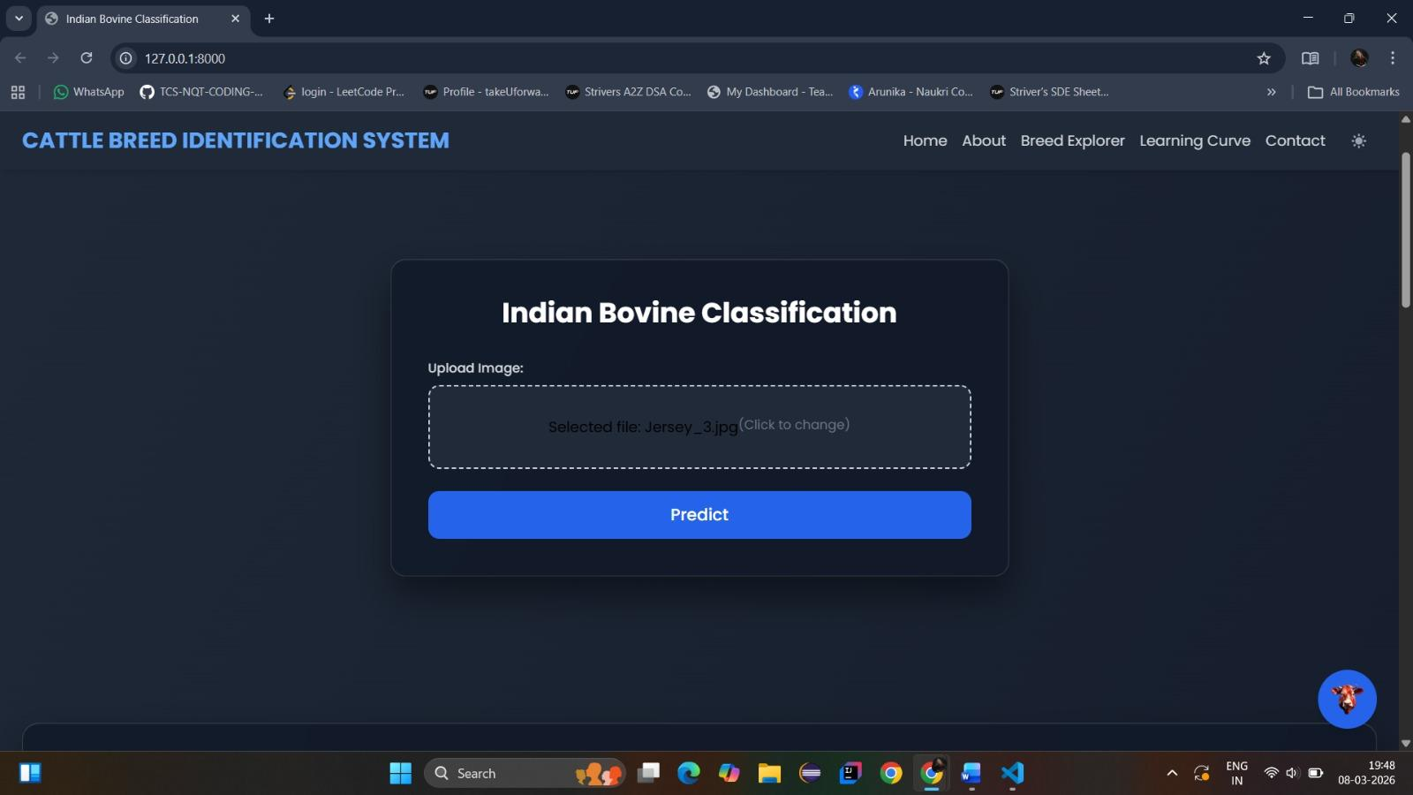
Dr. NGP INSTITUTE OF TECHNOLOGY
Output Screenshot
8-Mar-26
8-Mar-26
8-Mar-26
Department of AI&DS
Department of AI&DS
Department of AI&DS
34
34
34

Slide 35
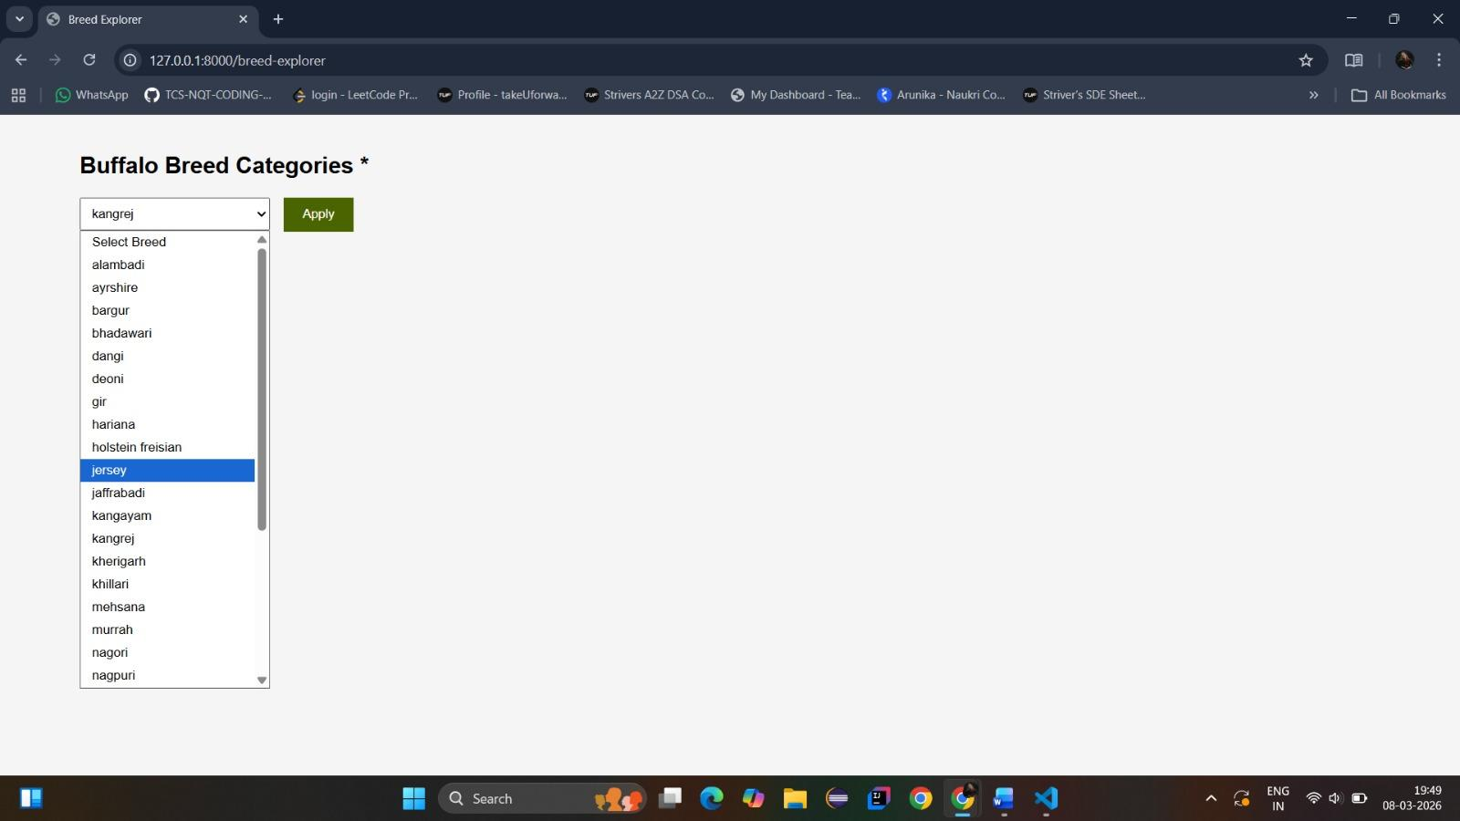
Dr. NGP INSTITUTE OF TECHNOLOGY
Output Screenshot
8-Mar-26
8-Mar-26
8-Mar-26
Department of AI&DS
Department of AI&DS
Department of AI&DS
35
35
35

Slide 36
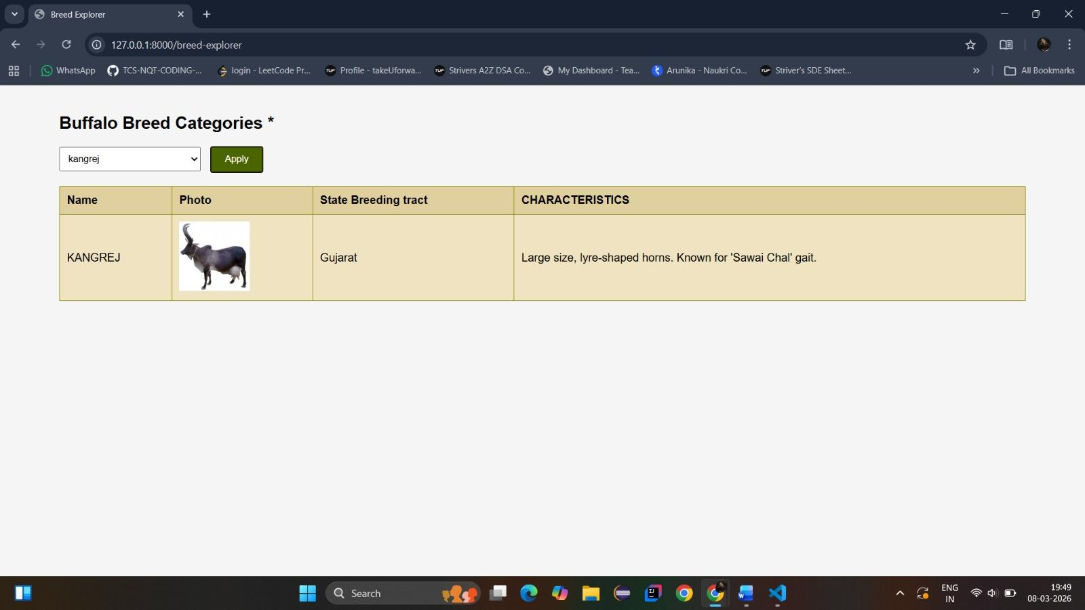
Dr. NGP INSTITUTE OF TECHNOLOGY
Output Screenshot
8-Mar-26
8-Mar-26
8-Mar-26
Department of AI&DS
Department of AI&DS
Department of AI&DS
36
36
36

Slide 37
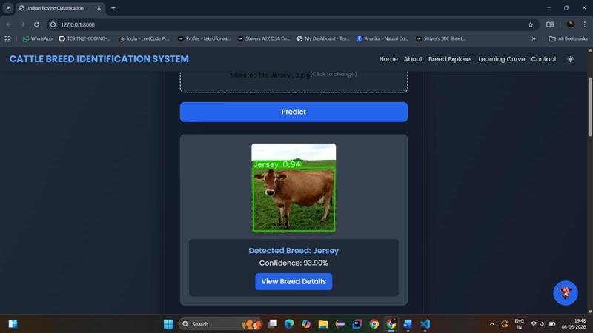
Dr. NGP INSTITUTE OF TECHNOLOGY
Output Screenshot
8-Mar-26
8-Mar-26
8-Mar-26
Department of AI&DS
Department of AI&DS
Department of AI&DS
37
37
37

Slide 38
Dr. NGP INSTITUTE OF TECHNOLOGY
Future Enhancement
Integration with Bharat Pashudhan App To support real-time breed validation during livestock registration by Field Level Workers.
Expansion of Breed Dataset Include more indigenous and crossbred cattle and buffalo breeds to improve system accuracy.
Mobile Application Development Enable field-level usage through a mobile app for easy image capture and prediction.
8-Mar-26
8-Mar-26
Department of AI&DS
Department of AI&DS
38
38

Slide 39
Dr. NGP INSTITUTE OF TECHNOLOGY
Conclusion
The project demonstrates the effective use of deep learning and computer vision for automated breed identification of dairy cattle and buffaloes.
The AI-based system reduces human dependency and improves accuracy by analyzing visual and morphological features.
The web-based implementation enables real-time predictions with confidence scores, enhancing usability and decision-making.
Overall, the system validates the feasibility of AI-assisted livestock management and supports the digital transformation of the agricultural sector.
8-Mar-26
8-Mar-26
Department of AI&DS
Department of AI&DS
39
39

Slide 40
Dr. NGP INSTITUTE OF TECHNOLOGY
References
A. Sharma et al., “Deep Learning Models for Livestock Breed Identification,” IEEE Access, vol. 11, pp. 12345–12356, 2023.
Ministry of Fisheries, Animal Husbandry & Dairying, Bharat Pashudhan App, Govt. of India, 2022.
R. Singh and K. Mehta, “Applications of Computer Vision in Precision Livestock Farming,” Computers and Electronics in Agriculture, vol. 198, 2022.

Slide 41
Dr. NGP INSTITUTE OF TECHNOLOGY
THANK YOU
8-Mar-26
8-Mar-26
42
42

Slide 42
Dr. NGP INSTITUTE OF TECHNOLOGY
Dr. NGP INSTITUTE OF TECHNOLOGY
Paper Status
14th International Conference on Contemporary Engineering and Technology – ICCET 2026
Paper Status: (ACCEPTED)
Paper ID: ICCET260592
Paper Title: AI-Driven Cattle Breed Identification and Livestock Monitoring for the Indian Agricultural Ecosystem
8-Mar-26
Department of AI&DS
41

